Slide 1

Prism Plus Refracted

Slide 2








Executive Summary
Prism Plus has sacrificed
Gross profit for Gross Revenue
with over inflated discounts
In the long run Prism Plus has failed to exploit its most profitable segments
A reversal in conversion rate shows prism plus
is not exploiting peak season spending habits
Recommendation
Implement a £10 annual subscription fee for free shipping and replace tiered discounts with a flat 5% discount for all subscribers
Recommendation
Use customer segmentation for target marketing efforts on Prism Refracted test group
Impact
Combining tier systems into one
profit-focused test group creates opportunities for profit-centred marketing.
Impact
If only 50% of our 2022 test customers subscribe will see an increase of £50,000 of annual revenue
Impact
Free shipping not only
incentivises retention but
leverages impulse purchasing
increasing conversion

Slide 3
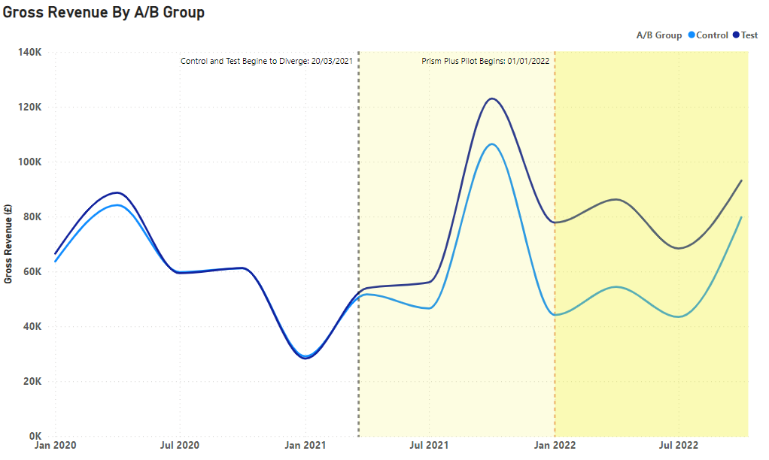
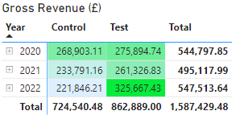
Gross Revenue initially looks good for Prism Plus
Test and control diverged prior to pilot indicating improper segmentation
The pilot appears to soften the 2021
peak season drop off

Slide 4
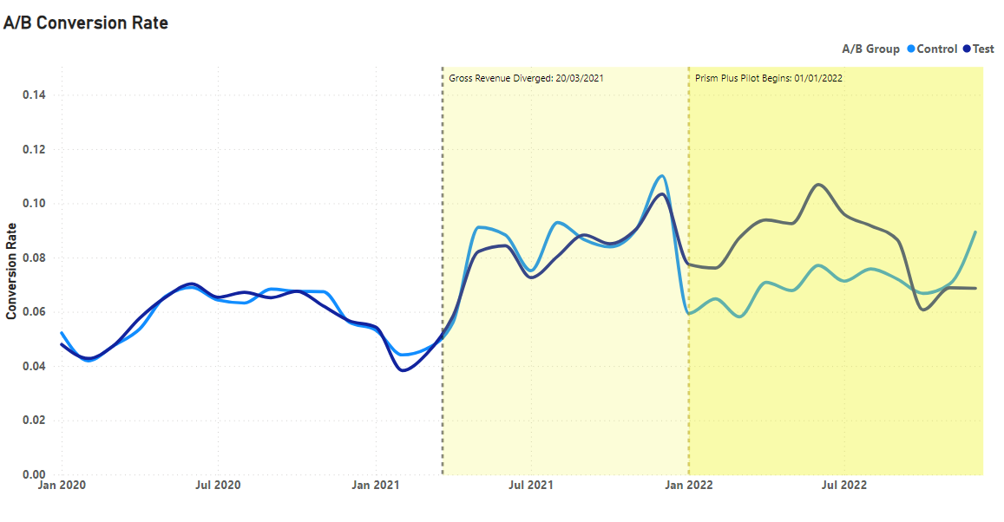
Conversion Rate follows a somewhat similar trend to Gross Revenue
Test and control diverged prior to pilot indicating improper segmentation
The pilot again appears to soften the 2021
peak season drop off
01/11/22 A reversal in conversion rate shows prism plus is not exploiting peak season spending habits

Slide 5

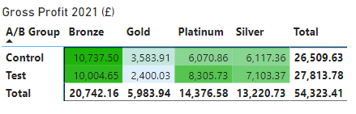
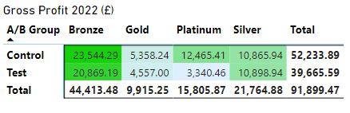
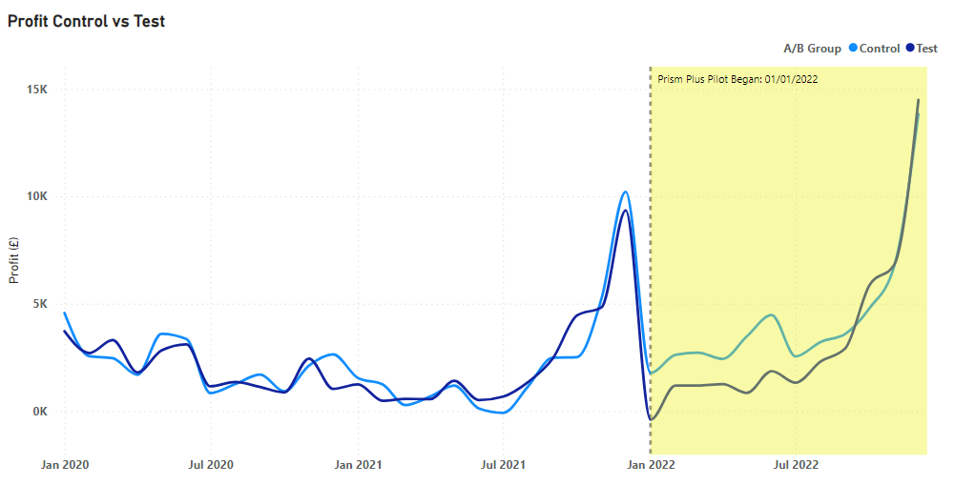
A deeper dive into Gross Profit shows Prism Plus has failed
Overall Gross profit growth 2021- 2022 is good
Control group profit is considerably higher than test

Slide 6
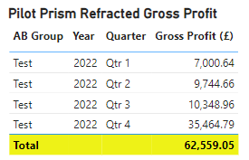
Introducing Prism Refracted
A subscription service offering free shipping
Recommendation - Introduce a flat annual subscription fee of £10 for free shipping whilst replacing tiered discounts with a flat 5% discount for all subscribers
Impact - If only 50% of our 2022 test customers subscribe will see an increase of £50,000 of annual revenue
Recommendation – Use customer segmentation for target marketing efforts on Prism Refracted test group
Impact - Integrating tier systems to one test group that’s profit-centred allows opportunities for more profit-focused marketing
Impact - Free shipping not only incentivises retention but leverages impulse purchasing increasing conversion

Slide 7
Thank you for listening Questions

